Slide 1
Reengineering the Audit with Blockchain and Smart Contracts
Presented by:
Andrea M. Rozario
Ph.D. Candidate
Rutgers Business School

Slide 2
Why blockchain for auditing?
Lower risk of management override than in an ERP system, no “super user” role in blockchain and it is difficult to alter records (Ibrahim 2017; Glaser 2017; Olsen et al. 2019)
Secure platform for third party monitoring, “guard the guards”, and enhance trust in the capital markets (Alles et al. 2004)
Mitigate the risk of manipulation of audit workpapers
Proactive inspection process to detect deficiencies near real-time
Optimize the use of blockchain for auditing given its increasing adoption

Slide 3
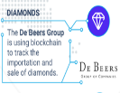
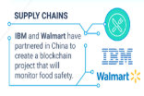
Introduction
Blockchain is a decentralized, distributed, and secure ledger originally developed for Bitcoin transactions
Types of blockchain databases: public (permissionless), private (permissioned)
Smart contracts autonomously execute the tasks for terms of contracts but can be useful in an auditing context
Blockchain and smart contracts can change the way audits are performed and disseminated
Source: https://medium.com/@matteozago/50-examples-of-how-blockchains-are-taking-over-the-world-4276bf488a4b

Slide 4
Objectives
How can auditors leverage blockchain and smart contracts as audit data analytic tools to enhance audit quality?
Map the characteristics of blockchain that can enhance audit evidence to PCAOB requirements
Propose an external audit blockchain supported by a variety of smart audit procedures
Propose novel functions for the PCAOB and a holistic audit framework

Slide 5
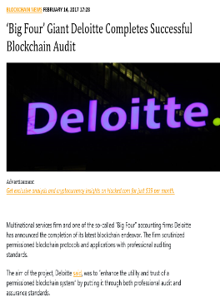
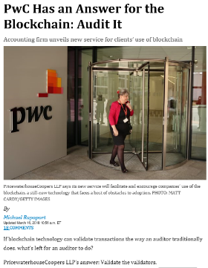
Motivation
Information Gap – Financial Statement Users
Performance Gap - PCAOB
Expectations gap
Increasing adoption of blockchain
Important to explore how auditors can leverage blockchain and smart contracts to narrow gap

Slide 6
Blockchain can Improve the Reliability of Internal and External Audit Evidence
Requirements of audit evidence: sufficiency, relevance and reliability (PCAOB AS 1105 2010)
Challenges of Gathering Audit Evidence | Blockchain Attributes | Blockchain Benefits
Traceable origins of sources (veracity) | Decentralization Immutability Accountability | Data Integrity to improve the reliability of audit evidence
Disaggregated data sources (variety) | Decentralization | One distributed depository for financial and nonfinancial data to improve the accuracy and timeliness of audit procedures and obtain a deeper understanding of the client

Slide 7
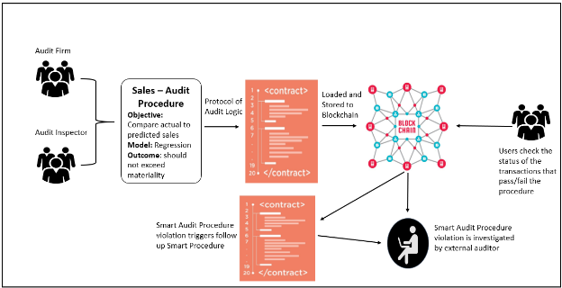
Blockchain Audit Evidence and Smart Audit Procedures can Improve Audit Quality and Reporting

Slide 8
Interlinked Blockchain Ecosystems
Audit PBC Ecosystem
Smart Audit Procedures
Revenue Analytics
PCAOB
Public Parties
SEC
Smart Controls
&
Smart Analytics
Auditor
Audit Committee
Business PBC Ecosystem
Bank
Supplier
A
Auditor
Customer A
Customer B
Client

Slide 9
Evolving the role of the PCAOB
The PCAOB oversees audit firms to ensure audits are conducted in accordance with GAAS
Seeks to improve their inspection process
Expected to enhance efficiency by relying on technology
New role for PCAOB as an active node on the audit blockchain to validate smart audit procedures and review their results
Issues such as the performance of inadequate audit procedures can be mitigated

Slide 10
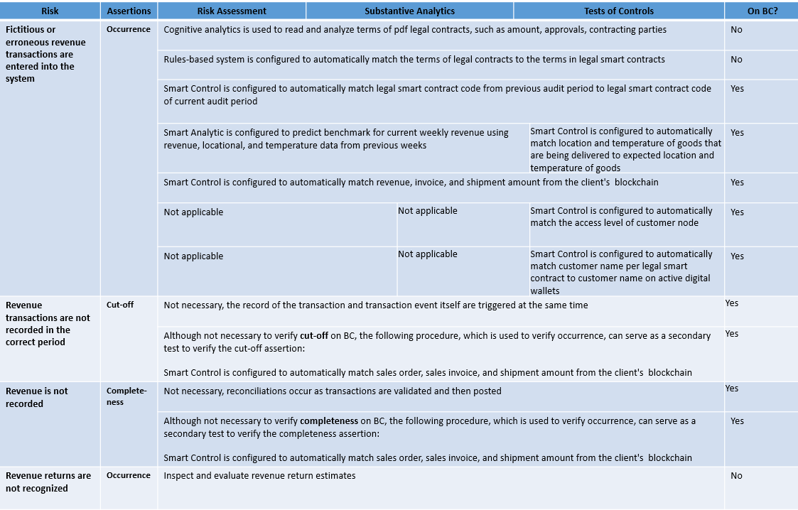
Holistic Audit Approach for Revenue

Slide 11
Issues and Future Research
Limitation | Future Research
Computational power | Why do users of private and permissioned blockchains opt out of using centralized databases?
Storage capabilities | Which methods can meet the demand to store big data on the blockchain?
Cybersecurity risk | How to design and implement a continuous monitoring system to reduce the risk of collusion on the blockchain network?
Litigation risk | How much transparency should be provided to financial statement users while maintaining an acceptable level of audit litigation risk?
Vulnerability of smart contracts | What are the quality processes that public accounting firms should have in place to ensure smart audit procedures are free of error?
Regulatory acceptance | How will the oversight model of financial statement audits be disrupted?
Economics | Would blockchain and smart contracts be developed in-house, or would it be outsourced?

Slide 12
Contributions
Explores the evolution of auditing in light of blockchain of smart contracts by:
Proposing an external audit blockchain supported by smart audit procedures
Discussing the issues related to the application of these technologies
Existing audit risks were considered, new audit risks may emerge
Described purpose and usefulness of the external audit blockchain
Limitations and Future Research

Slide 13
Thank you!

